Slide 1

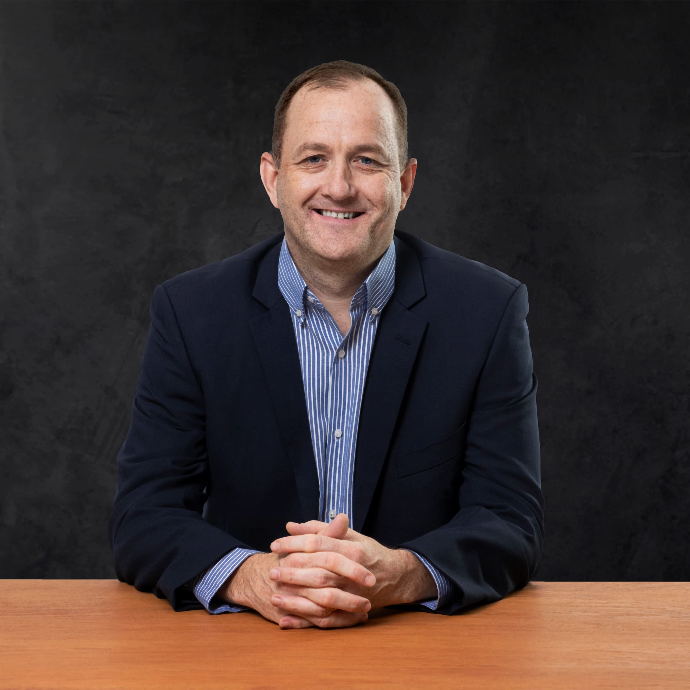
Increment Planning 18
Brett CHOLET
Executive General Manager for Australian Operations
Hastings Deering (Australia) Ltd
GUEST SPEAKER
Tuesday, 03 February 2026
Notes:
Brett is the Executive General Manager for Australian Operations at Hastings Deering. With a career spanning almost 30 years at Caterpillar dealers worldwide, Brett brings extensive experience to his Brisbane-based role.
Joining Hastings Deering in 2011, Brett’s roles with us include Product Support Manager, Area Manager for the Northern Territory, Executive Manager Business Centre Operations and Executive Manager - Customer Solutions.
Transitioning to broader responsibilities, Brett then became the Executive Manager for Parts, Components, and Service Solutions, overseeing diverse teams crucial to customer success. This laid the foundation for his current role, guiding Australian operations. Brett’s focus is on safety, sustainability, and efficiency, alongside supporting customers in being more successful with their Caterpillar equipment.
Brett started out as an Apprentice Fitter at H. Leverton, a Cat dealer in the United Kingdom, after completing his education in Liverpool and training in heavy construction plant. Brett then moved into international roles with Caterpillar dealers, including a Branch Manager role in Ghana, Service Operations Manager in Egypt, and Regional Manager for six countries in Africa with the Mantrac Group.
Outside of work, Brett enjoys supporting his wife and two children in their sporting and career endeavours and he is also an avid motorsports fan.

